Slide 1

Quickbooks Online
Set up and Bank Feeds

Slide 2
Setting Up Your Company
Create a New QBO Company
Using your web browser – navigate to qbo.intuit.com
Create an account – select a plan
Simple start – the most inexpensive and has all the basic bookkeeping needs
Includes one user plus an outside accountant
does not include payroll but can be added anytime for an additional fee

Slide 3
Setting Up Your Company
Other versions are Essentials, Plus and Advanced – these allow for additional users, more comprehensive reports, inventory and other advanced options
We recommend starting with Simple Start and if these features are desired – you can upgrade at any time. Similarly – if you choose a plan that is too advanced – you can downgrade at any time also.

Slide 4
Setting Up Your Company
Create an account – you will need an email address, password and ideally a cell phone.
There WILL be 2 step authentications!
Quickbooks will walk you through many questions regarding the company, who you are and what all you want Quickbooks to do
If you missed something in the setup – you can always go back to the settings and change any information needed.

Slide 5
Bank and Credit Card Feeds
Connect your Quickbooks to your Bank
Automatically imports from bank every night
Connect your bank – enter your bank name - QB will then ask you to sign into your bank (through QB) with the usual security features that your bank uses
If you have more than one account at this bank – choose all that apply to this company
For each bank account – you then select from a drop down the QB account to ‘tie’ it to

Slide 6
Bank and Credit Card Feeds
Choose how far back to pull in the bank info.. This may be limited due to your own bank parameters
When connection is complete – you will see all the transactions under each account in the ‘Bank Transactions’ screen
Simply click on a row – so example check #437 – then add the vendor and the income/expense that it should go to - and then click ‘Add’

Slide 7
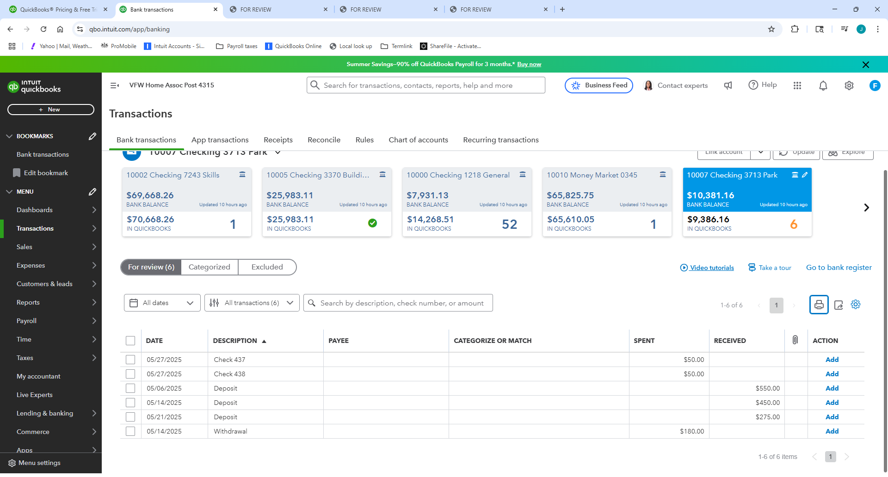
Bank and Credit Card Feeds

Slide 8
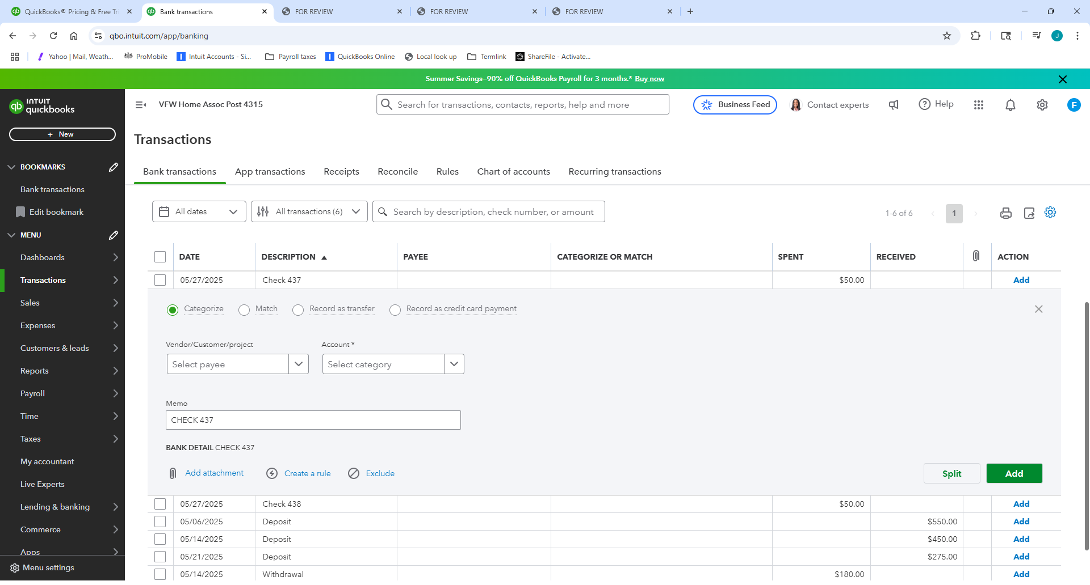
Bank and Credit Card Fees

Slide 9
Bank and Credit Card Fees
When using a debit or credit card – QB will try to automatically categorize the transactions – these will show in green – if you approve simply hit ‘Add’ – if not – click on the transaction and choose the account you want.
If the expense needs further breakdown – for example ‘Sam’s Club’ is more than just ‘food’ – so you choose ‘Split’ and you can breakdown the total to food, bar supplies, office supplies, etc

Slide 10
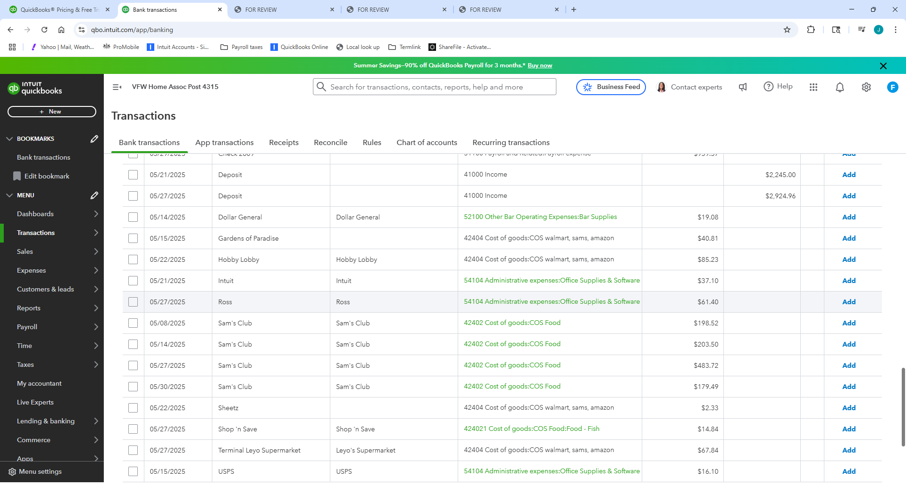
Bank and Credit Card Feeds

Slide 11
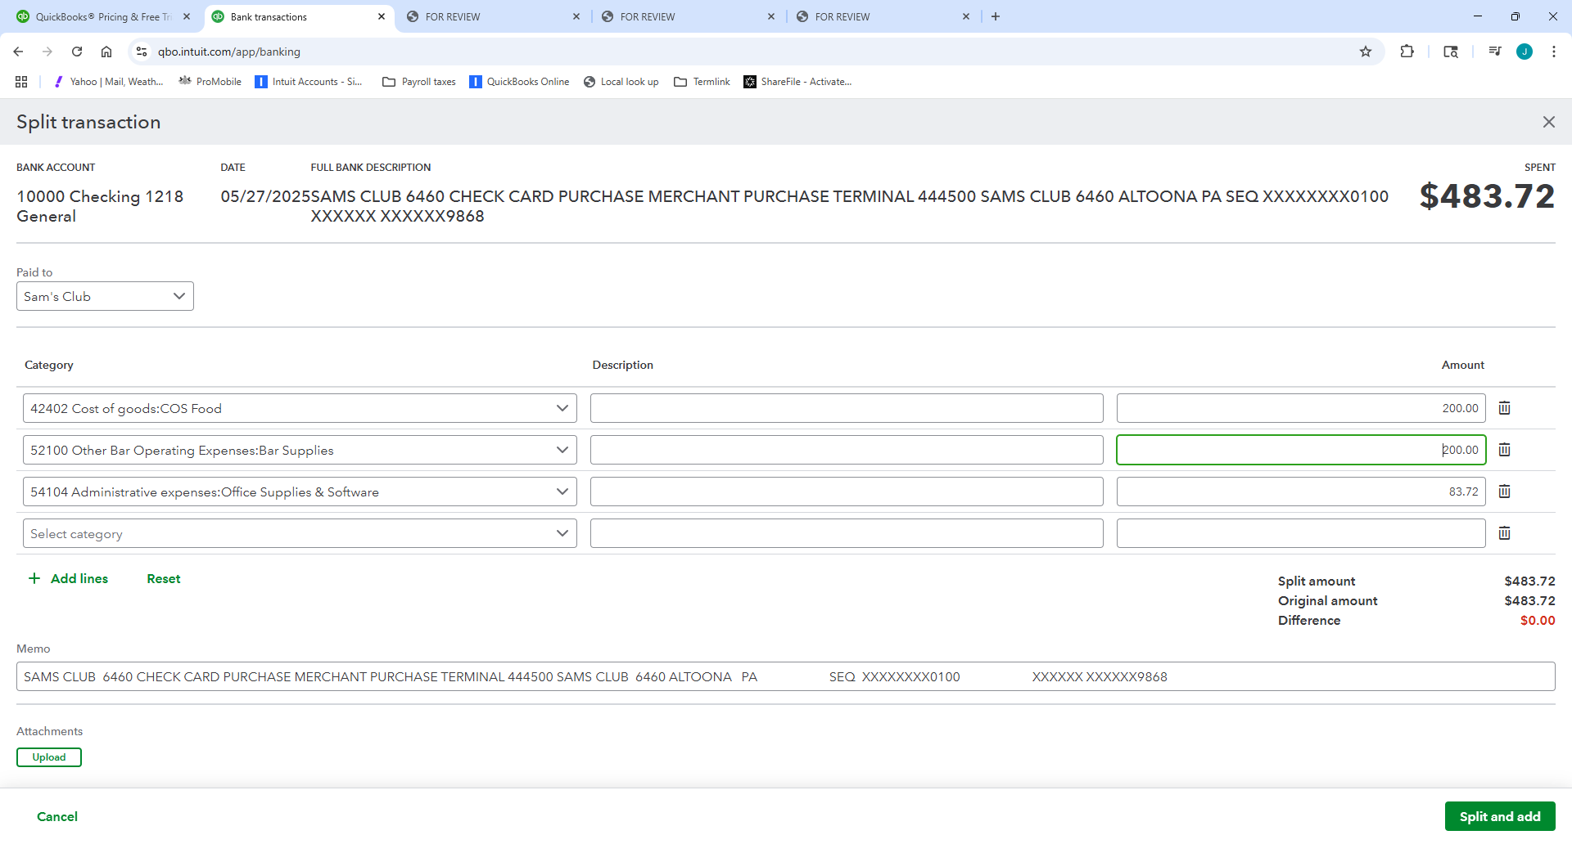
Bank and Credit Card Feeds

Slide 12
Bank and Credit Card Feeds
As you enter transactions – QB will remember which account was used and will recommend for the next transaction.
This is a time saver but you still need to review for accuracy.
When you have classified all the transactions – you will get a green checkmark!

Slide 13
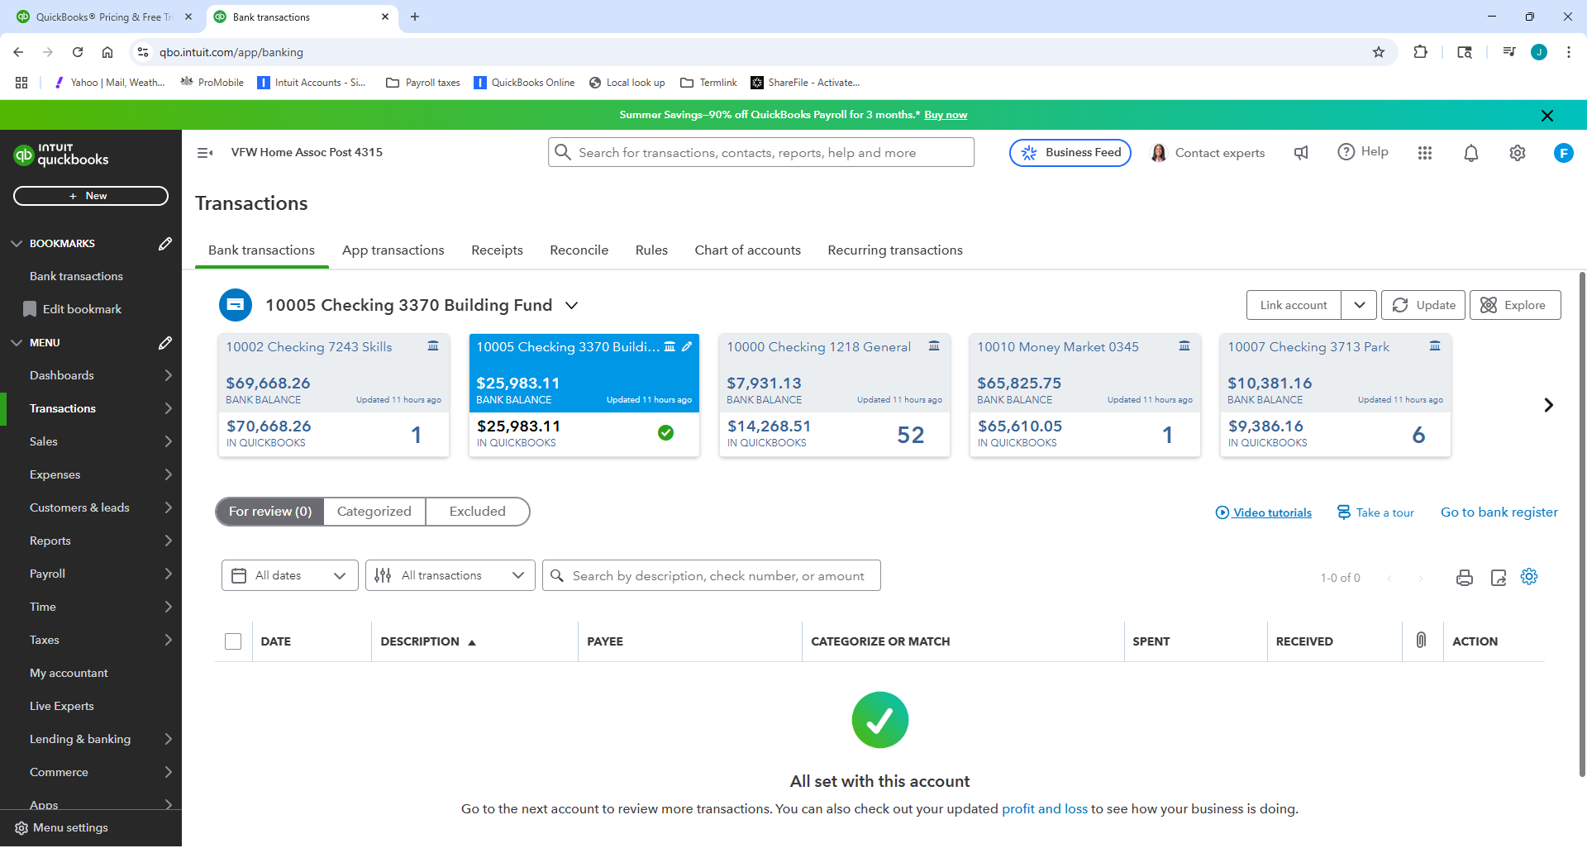
Bank and Credit Card Feeds

Slide 14
Bank and Credit Card Feeds
When the month is over – reconciling the account is all but done for you by QB – because QB already knows what cleared the bank and what didn’t. You will still need to review and ‘Finish’.
Any changes that are needed can be done from this screen

Slide 15
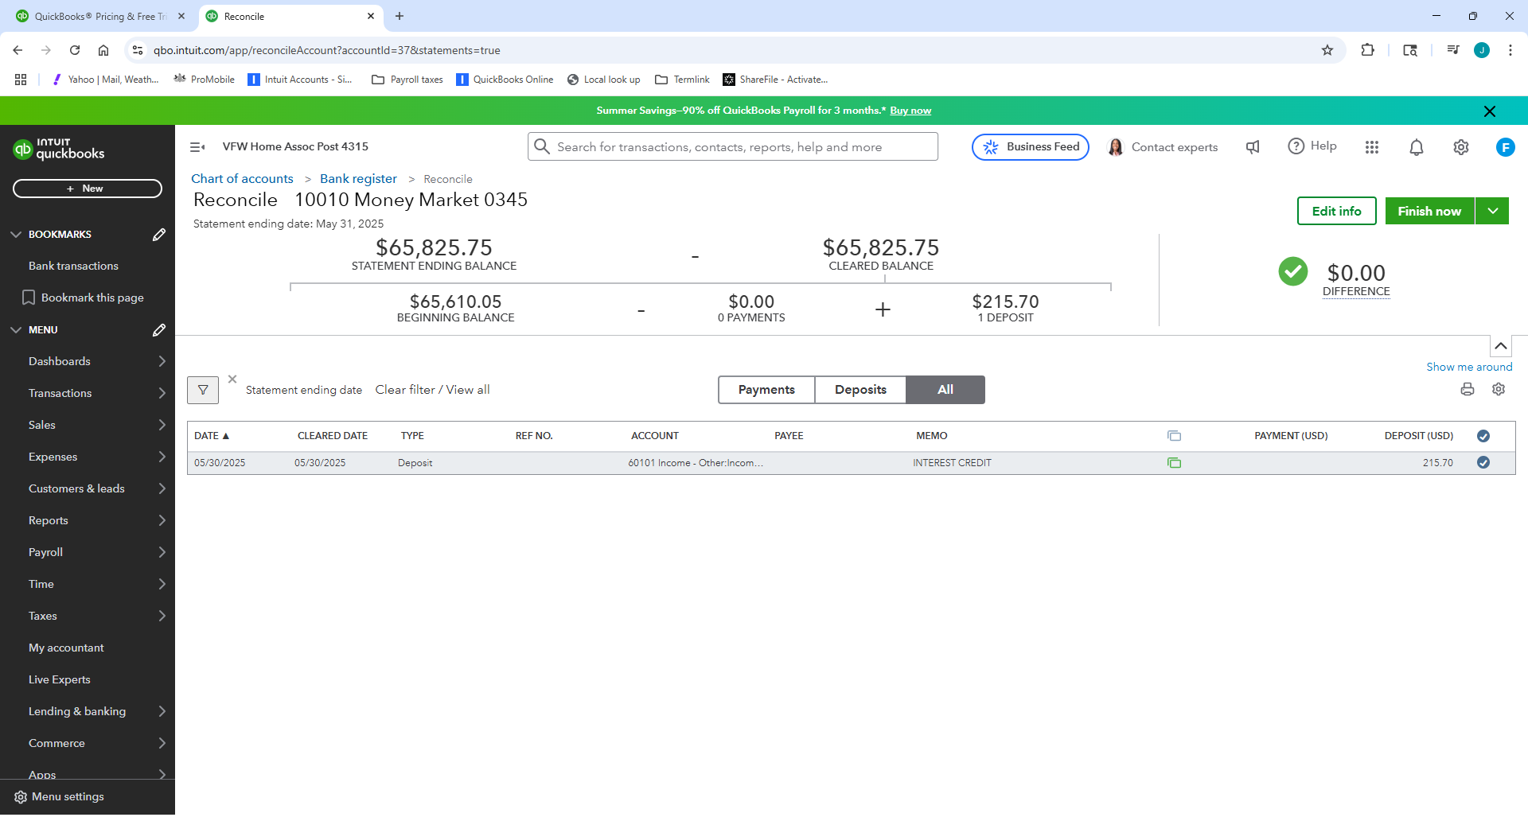
Bank and Credit Card Feeds

