Slide 1
VA S.A.V.E. Training
Office of Suicide Prevention
(Updated January 2025)

Slide 2
Welcome: Lebanon Suicide Prevention Team
Andrea Moult, LCSW 717-272-6621 x 3931: Program Manager
John Lucas, LISW-S 717-272-6621 x 4366: Suicide Prevention Coordinator
Rebecca Sanders, LCSW 717-272-6621 x 3437: Suicide Prevention Social Worker
Charlee Redick, LCSW 717-272-6621 x 4048: Suicide Prevention Social Worker
Mitch Stokes, MSW 717-272-6621 x 4101 Suicide Prevention Social Worker
Krista Herr, PSA 717-272-6621 x 4268 Program Support Assistant
Lebanon Suicide Prevention Team
Email- VHALEBSPC@VA.GOV
Phone: Ext. 4101

Slide 3

Before We Begin:
Suicide is an intense topic for some people.
  If you need to take a break, or step out, please do so.
  Immediate Resources:
    988 Suicide and Crisis Lifeline
    Veterans and service members: Dial 988 then Press 1 to connect with the Veterans Crisis Line.
    Emergent Concerns – 911 if in community, DOM, and/community outpatient clinics.
Notes:
Today we will discuss ways that everyone can contribute to a safer environment for Veterans at risk for suicide. We understand that suicide is a sensitive topic and that people in attendance today may have had personal experiences involving suicide. If you find you need to take a break, please do so. Feel free to reach out to me at the end of the presentation if you need support. If you find you need to talk to someone at any time, you can call the 988 Suicide and Crisis Lifeline at 988 (service members and Veterans should Dial 988 then Press 1 to connect with the Veterans Crisis Line). Why don’t we all put this number into our phone contacts right now?

Slide 4
Overview
Objectives
Facts about Veteran Suicide
Common Myths vs. Realities
VA S.A.V.E. Steps
Resources
Notes:
This program is focused on preventing suicide attempts and saving lives that might otherwise be lost to suicide. It is designed to train everyone who knows a Veteran to be a “gatekeeper.” The role of gatekeepers is connecting those at risk for suicide with people who can help them. You can save lives by being sensitive to people in distress and by connecting them with care.

Slide 5
Objectives
By participating in this training, you will:
Have a general understanding of the scope of Veteran suicide within the United States.
Know how to identify a Veteran who may be at risk for suicide.
Know what to do when you identify a Veteran at risk.

Slide 6
Take a moment to consider:
What concerns do you have about suicide and how to communicate with Veterans in crisis?
I was both scared and felt helpless because I could not do anything either way in the situation, but on the other hand, I was involved and had a responsibility.
One gets scared of the forces expressed in "I want to commit suicide". You are supposed to be professional, on the other hand one also has personal feelings, which patients like these, really can stir. One might get upset, feel pain and fear.
How good are we at picking up those who are really at risk to commit suicide? There is no guarantee that a patient will survive to the next day even if he has been to the doctor.
The personal experience was grief, I had talked to him just a few days before this happened, so it was close. I reacted immediately with a sense of fright, what have I done?
Høifødt, T. S., & Talseth, A.-G. (2006). Dealing with suicidal patients – a challenging task: A qualitative study of young physicians’ experiences. BMC Medical Education, 6(1). https://doi.org/10.1186/1472-6920-6-44

Slide 7
Facts About Veteran Suicide

Slide 8
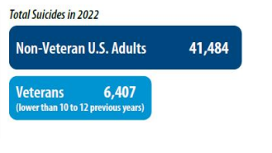
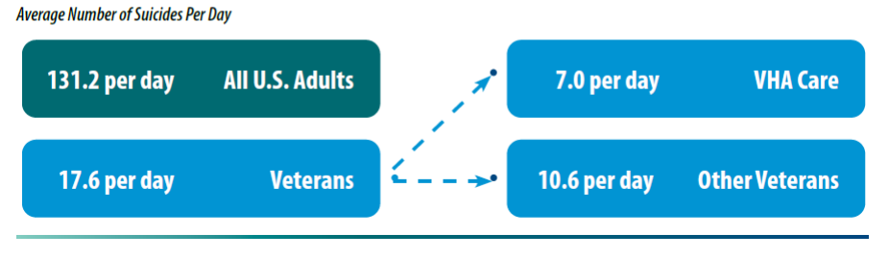
Suicide is a National Public Health Issue
Suicide is a national issue, affecting both the Veteran and general population.
Notes:
In 2022 among all U.S. adults, there were, on average, 131.2 suicides per day. • This includes 17.6 Veteran suicides per day. o On average, 7.0 suicides per day were among Veterans who received VHA care in 2021 or 2022 and 10.6 were among other Veterans.

Slide 9
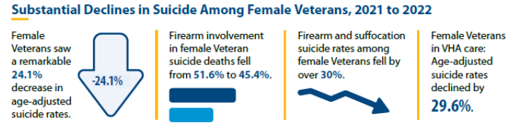
Anchors of Hope: Female Veterans

Slide 10
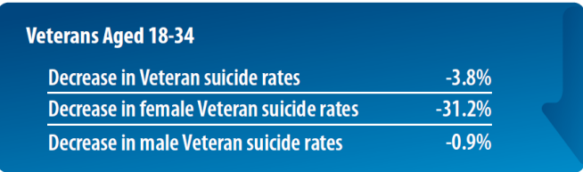
Anchors of Hope: Age

Slide 11
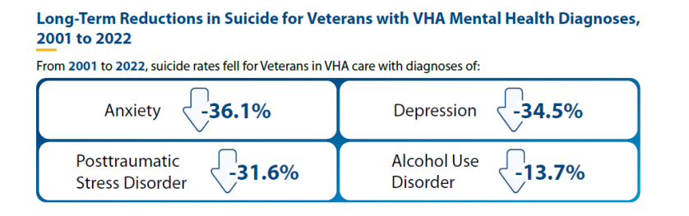
Anchors of Hope: Diagnoses

Slide 12
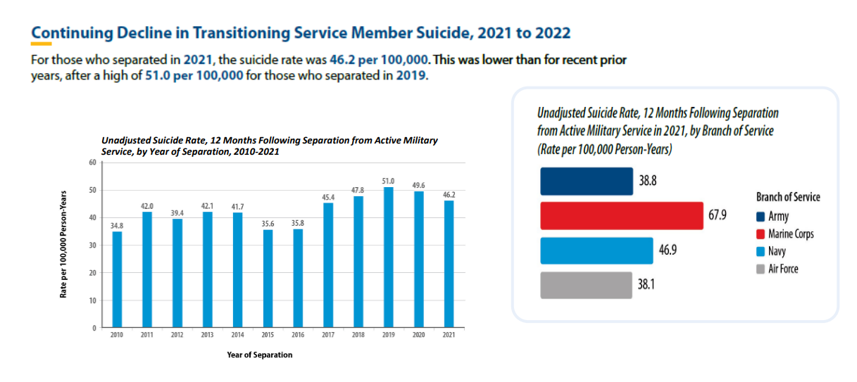
Active-Duty Separation: Branches

Slide 13
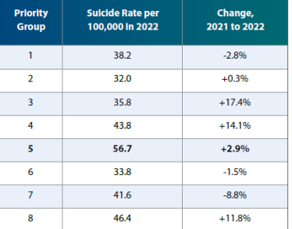
Priority Groups: Suicide Rates 2021-2022
Notes:
Priority Group 5: Veterans with a non-service-connected disability or non-compensable service-connected disability rated as 0% disabling by the VA and whose annual income and net worth are below the VA pension benefits national income threshold, OR
Veterans receiving VA pension benefits, OR
Veterans eligible for Medicaid programs
Department of Veterans' Affairs Table of Priority Groups

Slide 14
Suicide is a Complex Issue with No Single Cause
Suicide is often the result of a complex interaction of risk and protective factors at the individual, community, and societal levels.
Risk factors are characteristics that are associated with an increased likelihood of suicidal behaviors. Protective factors can help offset risk factors.
To prevent Veteran suicide, we must maximize protective factors while minimizing risk factors at all levels, throughout communities nationwide.

Slide 15
Risk and Protective Factors
Risk
Protective
Prior suicide attempt
Mental health issues
Substance abuse
Access to lethal means
Recent loss
Legal or financial challenges
Relationship issues
Unemployment
Homelessness
Access to mental health care
Sense of connectedness
Problem-solving skills
Sense of spirituality
Mission or purpose
Physical health
Employment
Social and emotional well-being
Goal: Minimize risk factors and boost protective factors
Notes:
Risk factors are characteristics that are associated with an increased likelihood of suicide behaviors. Some risk factors for suicide include: prior suicide attempt history, certain mental health conditions, access to lethal means, and stressful life events, such as divorce, job loss, or the death of a loved one.
Protective factors can help offset risk factors. These are characteristics associated with a decreased likelihood of suicide behaviors. Some protective factors for suicide include access to mental health care, feeling connected to other people, and positive coping skills.

Slide 16
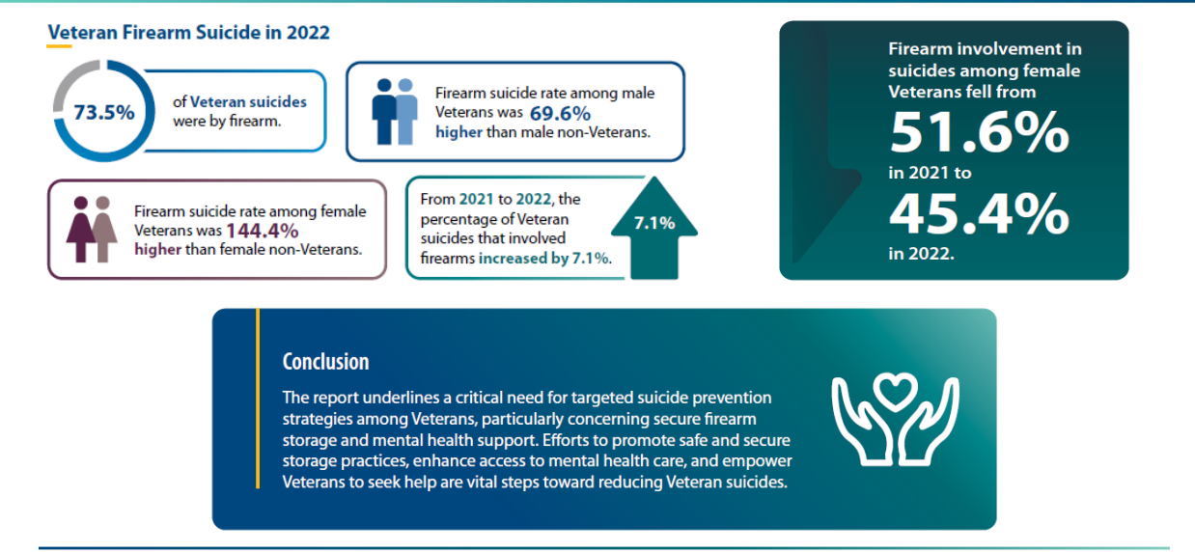
Leading Lethal Means

Slide 17
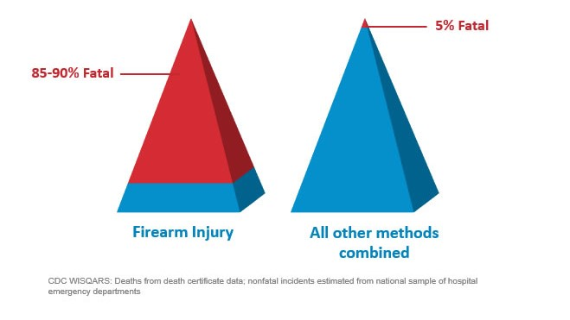
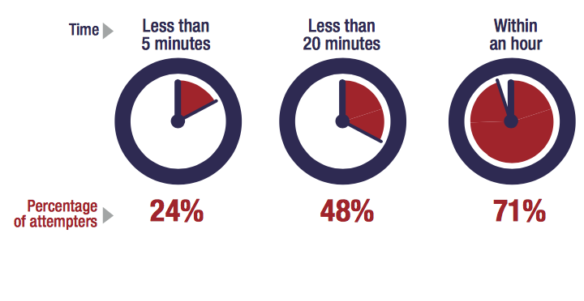
Most Suicide Crises are Brief
Time from Decision to Action < 1 hour
Source: Simon, T.R., Swann, A.C., Powell, K.E., Potter, L.B., Kresnow, M., and O’Carroll, P.W. Characteristics of Impulsive Suicide Attempts and Attempters. SLTB. 2001; 32(supp):49-59.
Source: CDC WISQARS and US Dept. of Veterans Affairs
https://www.mirecc.va.gov/lethalmeanssafety/facts/
Notes:
Building in time and space between a person with thoughts of suicide and a suicide method saves lives.
While some suicide crises last a long time, most last minutes to hours. In one study of suicide attempt survivors:
47 percent said it took less than one hour between their decision to attempt suicide and their actual attempt.
24 percent said it took less than five minutes for them to act.
The time between when a person decides to die by suicide and when they act on the decision is often very short. A 2005 study found that 71% of attempters estimating that the process took less than an hour. This reality underscores the importance of reducing access to means for those who are at elevated risk for suicide, until the risk period passes.
Access to lethal means increases suicide risk for everyone living in the home
Acute phase of a suicidal crisis is often brief.
Building in time and space—even 30-60 minutes—between impulse to act and the means to harm one’s self saves lives
We know that people rarely “substitute” one means for another. So, it is important to restrict whichever means they have in mind to use.
Means matter—how a person attempts suicide impacts how fatal the injury will be.
About 90% of firearm-related suicide attempts are fatal, as compared to approximately 5% of suicide attempts by all other mechanisms combined
Most who survive a nonfatal suicide attempt do not go on to die by suicide
Building in time and space between the impulse to act and the means to harm one’s self saves lives.
While some suicidal crises last a long time, most last minutes to hours. In one study of suicide attempt survivors:
47 percent said it took less than one hour between their decision to attempt suicide and their actual attempt.
24 percent said it took less than five minutes for them to act.

Slide 18
Lethal Means Restriction
Put time and distance between means – Saves lives
  Gun Lock, Gun Safe, Storing Ammunition Separately, asking a family member or friend to hold on to.
  Pill Box – locked pill box, Safely Dispose of unused medications.
  Naloxone Kits
  Two-week supply once discharged from inpatient stay
  Removing items from home (i.e. rope, poisons)
Notes:
Suicide is preventable, and preventive treatment works. Every day, people across the nation reach out for support and are able to live healthy, productive lives.

Slide 19
Lethal Means Safety Works
Reducing access to lethal suicide methods is one of the few population interventions that has been shown to decrease suicide rates.
About 90 percent of people who survive a suicide attempt do not go on to die by suicide.
If we can collaborate with Veterans ahead of time to help them survive a suicide crisis, we have likely prevented suicide for the rest of their lives.
Notes:
In 1997, Australia instituted stricter gun safety measures, including minimum age restrictions, psychological evaluations, background checks, and waiting periods. The firearm suicide rate steadily declined by 4.7% each year, and researchers did not see a substitution effect.

Slide 20
Common Myths vs. Realities
Notes:
Even though suicide is a major public health concern, there are a lot of common myths and misinformation about suicide. Let’s talk about some of these. Having accurate information about suicide makes it easier to reach out to others and help them.

Slide 21

Common Myths vs. Realities
Myth
Reality
Individuals who openly discuss suicidal thoughts are often perceived as merely seeking attention..

Slide 22

Common Myths vs. Realities
Myth
Reality
Regardless of the tone—whether casual or joking—suicide threats must never be dismissed, as they often reveal deep-seated thoughts of self-harm. When someone expresses suicidal feelings, it presents an important opportunity for others to step in and help before any actions are taken. Your intervention could make a profound difference.

Slide 23
Common Myths vs. Realities
Myth
Reality
The only individuals who can provide the necessary assistance to someone who is suicidal are mental health counselors or therapists.

Slide 24
Common Myths vs. Realities
Myth
Reality
While special training is not required to discuss the topic of suicide safely, it’s important to approach the subject with care. Additionally, helping someone feel included and offering genuine, heartfelt support can significantly impact them during difficult times.

Slide 25
The Steps of VA S.A.V.E.

Slide 26

VA S.A.V.E.: Teaching Communities How to Help Veterans at Risk for Suicide
VA S.A.V.E. will help you act with care and compassion if you encounter a Veteran who is in a suicide crisis.
Signs of suicidal thinking should be recognized.
Ask the most important question of all.
Validate the Veteran’s experience.
Encourage treatment and Expedite getting help.

Slide 27

Signs of Suicidal Thinking
Learn to recognize these warning signs:
Hopelessness, feeling like there is no way out
Anxiety, agitation, sleeplessness, or mood swings
Feeling like there is no reason to live
Rage or anger
Engaging in risky activities without thinking
Increasing alcohol or drug use
Withdrawing from family and friends

Slide 28
Signs of Suicidal Thinking
The presence of any of the following signs requires immediate attention:
Thinking about hurting or killing themselves
Looking for ways to die
Talking about death, dying, or suicide
Self-destructive or risk-taking behavior, especially when it involves alcohol, drugs, or weapons

Slide 29

Asking the Question
Know how to ask
the most important question of all…

Slide 30
Asking the Question
“Are you thinking about killing yourself?”

Slide 31
Asking the Question
Do’s | Don’ts
DO ask the question if you’ve identified warning signs or symptoms. | DON’T ask the question as though you are looking for a “no” answer. “You aren’t thinking of killing yourself, are you?”
DO ask the question in a natural way that flows with the conversation. | DON’T wait to ask the question when someone is halfway out the door.
Notes:
Use direct words and phrases, such as “killing yourself” and “suicide,” when asking about suicidal thoughts. Avoid using vague phrases such as “hurting yourself,” as these can have different meanings to different people. To emphasize this point, you can ask participants why it is so important to ask this question directly instead of indirectly. What may be the outcome of asking indirect questions? (Answer: indirect answers!)
Ask a direct question if warning signs (“invitations”) are evident. When “invitation statements” have been made, it can be helpful to use them as springboards to directly ask about a person’s risk for suicide. (E.g., “I want to better understand what you mean by ‘ending it all.’ Are you thinking about killing yourself?”)
Phrase questions in a way that indicates openness to listening and remain nonjudgmental no matter the answer. This is extremely important, as it will help the Veteran understand that people are willing to listen.
The question should not be an afterthought. It should be asked promptly once someone indicates that they may be at risk for suicide.
There may not be an optimal time to ask the question, and doing so may be discomforting. Acknowledge this and encourage participants to ask the question anyway.

Slide 32
Asking the Question: Check-In & Practice
What are your thoughts about asking the question?
What initial concerns do you have?
Let me demonstrate a few ways of asking the question — both good and bad — and you can tell me which ones you think are most effective and direct.
Now, turn to a neighbor and practice asking the question with one of ways you feel would be most effective.

Slide 33

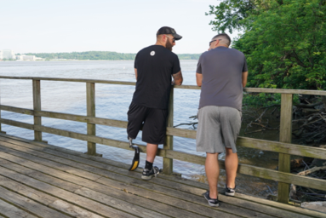
Validate the Veteran’s Experience
Talk openly about suicide. Be willing to listen and allow the Veteran to express their feelings.
Recognize that the situation is serious.
Do not pass judgment.
Reassure the Veteran that help is
available.

Slide 34
Validate the Veteran’s Experience: Check-In & Practice
Who can share with me a validating statement?
Turn to a partner and practice the following:
  In response to an “invitation statement” such as, “Everything is so hard. I feel like a drag on my friends.”
    Start by telling your partner, “Everything will be fine.” (Partner should respond.)
    Shift instead to a statement that validates their feelings. (Partner should respond.)
What did you notice?
Notes:
Examples of validating statements include:
“It’s normal for someone who’s going through what you’re experiencing to think about suicide. And I want to keep talking to see if we can find some ways to keep you safe.”
“Anyone in your situation would feel that way.”
“Of course you’re overwhelmed.”
“You have been struggling with a lot.”
“This would be too much for anyone to handle.”
Direct participants to turn to a partner and practice the following, in response to an “invitation statement” such as, “Everything is so hard. I feel like a drag on my friends”:
Start by telling your partner, “Everything will be fine.” (Partner should respond.)
Shift instead to a statement that validates their feelings. (Partner should respond.)
Pause to have participants reflect on the exercise. Ask: What did you notice?

Slide 35

Encourage Treatment and Expedite Getting Help
What should I do if I think someone is suicidal?
  Don’t keep the Veteran’s suicidal behavior a secret.
  Do not leave them alone.
  Try to get the person to seek immediate help from his or her doctor or the nearest hospital emergency room.
  Call 911.
Reassure the Veteran that help is available.
Call the Veterans Crisis Line at Dial 988 then Press 1.
Notes:
No keeping secrets- if someone says they will talk to you about an issue “only if you promise not to tell anyone,” it’s important to be up front in saying you cannot make that promise because you care about them and want them to get any help that they may need. You don’t want to keep a secret and regret it.

Slide 36
Encourage Treatment and Expedite Getting Help Cont.
Local Resources
  Behavioral health walk-in apts. available:
    Building 18, 2nd floor
    Outpatient Clinics (Berks, Cumberland, Lancaster, Schuylkill and York)
  Building 1 Emergency Department (24/7)
  Encourage person to seek immediate help from his or her doctor or the nearest hospital emergency room.
    COMPACT Act. – Cost free mental health and medical emergent suicide care that removes the cost barrier.
  Call 911.
Reassure the Veteran that help is available.
Call the Veterans Crisis Line at Dial 988 then Press 1.
Notes:
No keeping secrets- if someone says they will talk to you about an issue “only if you promise not to tell anyone,” it’s important to be up front in saying you cannot make that promise because you care about them and want them to get any help that they may need. You don’t want to keep a secret and regret it.

Slide 37
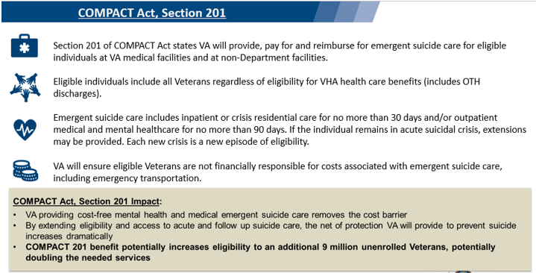
Encourage Treatment and Expedite Getting Help Cont.
Notes:
No keeping secrets- if someone says they will talk to you about an issue “only if you promise not to tell anyone,” it’s important to be up front in saying you cannot make that promise because you care about them and want them to get any help that they may need. You don’t want to keep a secret and regret it.

Slide 38
When Talking with a Veteran at Risk for Suicide
Remain calm.
Listen more than you speak.
Maintain eye contact.
Act with confidence.
Do not argue.
Use open body language.
Limit questions — let the Veteran do the talking.
Use supportive, encouraging comments.
Be honest — let the Veteran know that there are no quick solutions, but help is available.
Notes:
Open body language signals interest in the other person and in the conversation. Maintain a relaxed posture, lean in closer, use direct eye contact, and nod in agreement to show your Veteran that you’re present in the moment with them.

Slide 39
Practice Sessions
Goal: To develop a level of comfort and confidence in asking about suicide and helping a Veteran who is thinking about suicide.
Notes:
[Practice Sessions are a chance to practice VA S.A.V.E. skills. Encourage everyone to participate, but don’t worry if someone does not want to do it. It’s okay if they want to just watch. Flexibility is a strength here.
Depending on your group(s) and your time, you can have 1 or more role plays with a volunteer, or brainstorm role play responses with the whole group.
Use that attached role play materials to help your colleagues practice VA S.A.V.E. Keep slide 36 with the steps of VA S.A.V.E. visible for people to use.
Be positive and encouraging. Take a gentle, coaching approach. This is a sensitive issue, and a new skill for many people. If you mean well, and are doing your best, with VA S.A.V.E. skills, it will likely work out well.
Wrap up during last 5 min of the hour.

Slide 40
Practice Sessions
Imagine that you are talking to a friend, family member, or co-worker whom you know well. You also know this person has been having a lot of personal problems lately and seems to be withdrawing from activities, and overall seems “down” much of the time. They mention that everything feels “hopeless.”
Step 1: As you begin your conversation with them, listen for the problems that they believe suicide would solve and listen for a sign — an invitation statement. When you hear a warning sign, find a way to ask the question, e.g., “You seem very overwhelmed right now. Are you thinking about suicide?”
Step 2: As you listen, make sure to validate their experience or feelings. Continue to listen and try to expedite them to the appropriate level of care.
Switch roles.

Slide 41
Remember
VA S.A.V.E.
  S
  A
  V
  E
  Signs of suicidal thinking should be recognized.
  Ask the most important question of all.
  Validate the Veteran’s experience.
  Encourage treatment and Expedite getting help.

Slide 42

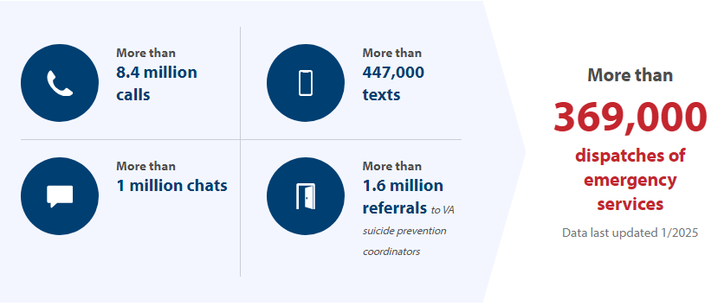
Veterans Crisis Line
About Us | Veterans Crisis Line

Slide 43

Remember
  Get to safety and call 911
If the Veteran has taken pills, cut himself or herself or done harm to himself or herself in some way
  911
Call the Veterans Crisis Line at 988, Press 1
Notes:
That’s a great question. The nice thing about S.A.V.E. training is that no one expects you or me to have all the answers. The Suicide Prevention Program is happy to follow up with us about any outstanding questions we may have. If you want, I can write down your question and ask them myself.

Slide 44
Resources
Notes:
Customize the Resources section based on your audience

Slide 45
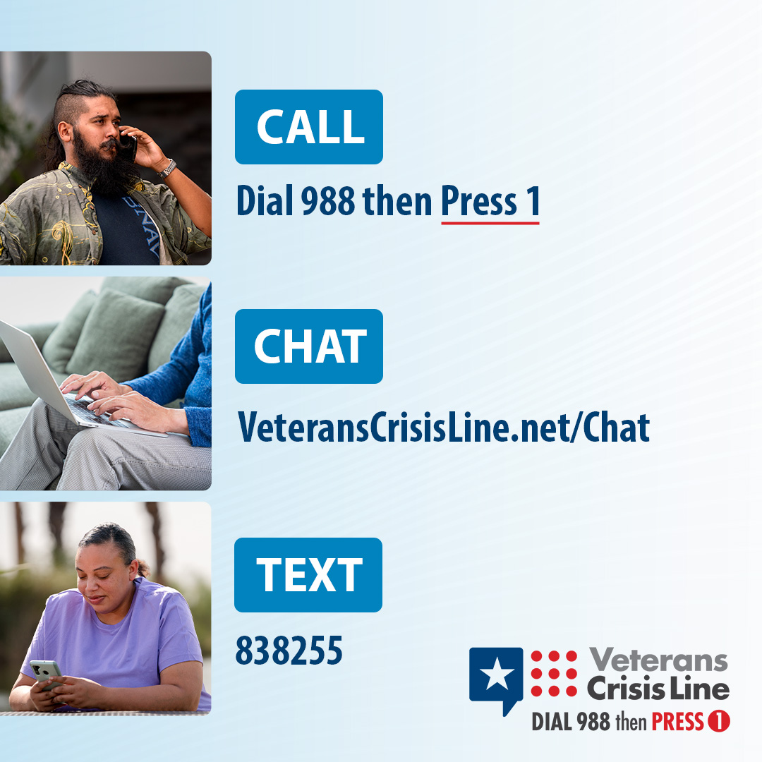
Free, Confidential Support 24/7/365
Veterans
Service members
Family members
Friends
Notes:
Veterans Crisis Line: The Veterans Crisis Line connects Veterans in crisis and their families and friends with qualified, caring VA responders through a confidential toll-free hotline, online chat, or text. Veterans and their loved ones can call 988 and Press 1, chat online, or send a text message to 838255 to receive confidential crisis intervention and support 24 hours a day, 7 days a week, 365 days a year. More information is available at https://www.veteranscrisisline.net/.

Slide 46
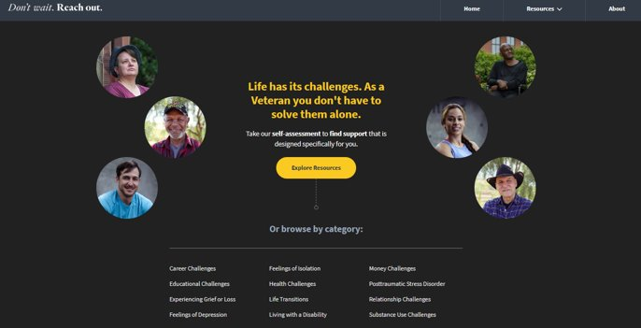
Don’t Wait. Reach Out.
Find the right Veteran Resources Quickly and Easily
Don't Wait. Reach Out. (va.gov)

Slide 47
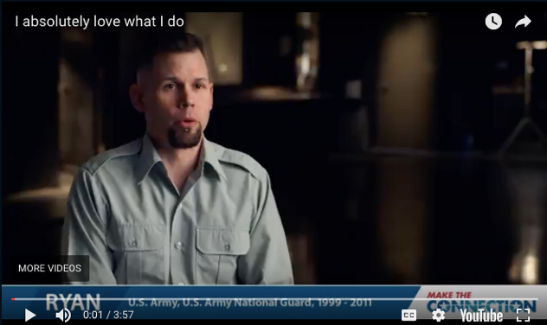
Make The Connection
Online resource featuring hundreds of Veterans telling their stories about overcoming mental health challenges.
https://maketheconnection.net/conditions/suicide
Notes:
Make the Connection: This online resource connects Veterans, their family members and friends, and other supporters with information and solutions to issues affecting their lives. More information is available at https://maketheconnection.net/.

Slide 48
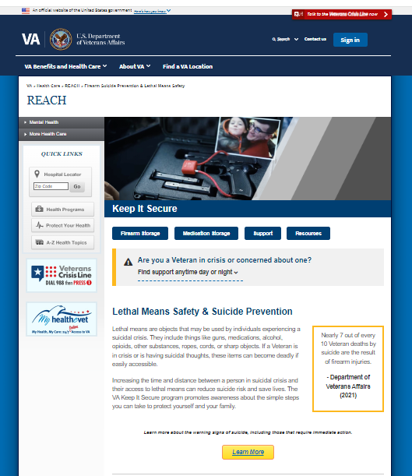
Practice secure storage of firearms, medications and other lethal means
Visit www.keepitsecure.net to learn more about the importance of firearm and other lethal means safety
Nearly half of all Veterans own a firearm, and most Veteran firearm owners are dedicated to firearm safety
Firearm injuries in the home can be prevented by making sure firearms are unloaded, locked, and secured when not in use, with ammunition stored in a separate location
There are several effective ways to safely secure firearms. Learn more and find the option that works best for you and your family from the National Shooting Sports Foundation at www.nssf.org/safety

Slide 49
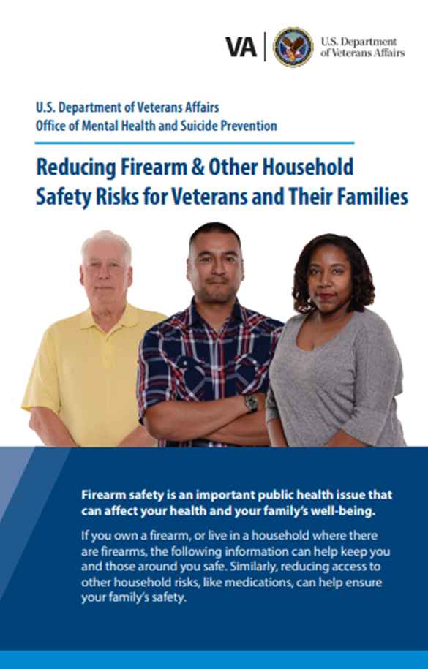
New Lethal Means Safety Resources
    Reducing Firearm & Other Household Safety Risks Brochure provides best practices for securely storing firearms and medications along with advice for loved ones on how to talk to the Veteran in their life about safe storage.

Slide 50
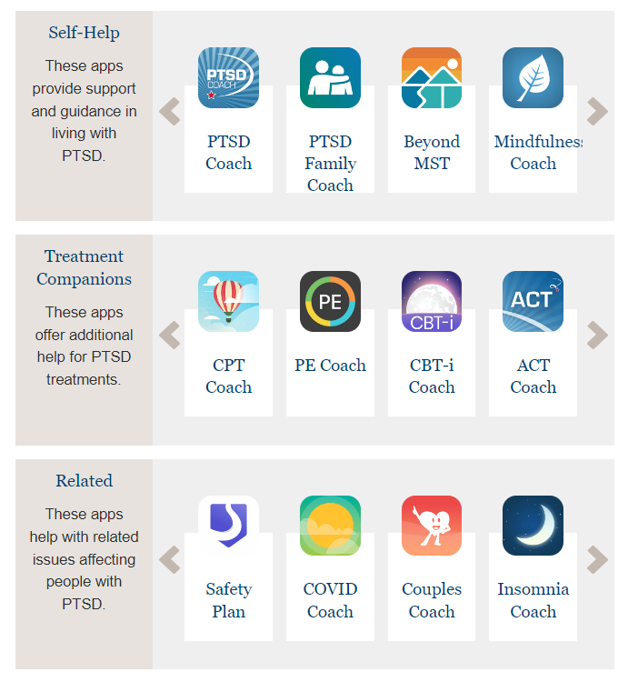
Mental Health Mobile Apps.
Mobile Apps - PTSD: National Center for PTSD (va.gov)

Slide 51

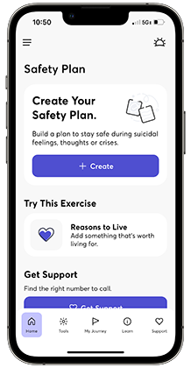
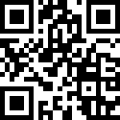
Check out the new Safety Plan app!
Safety Plan helps Veterans create a personalized step-by-step action plan to keep themselves safe during a crisis. It is highly customizable and provides access to coping tools, self-assessment measures, and crisis support resources like the Veterans Crisis Line. Download the app today by using the QR code, or by visiting the App Store or Google Play.
Note: Safety Plan is a U.S. Department of Veterans Affairs app, developed by the National Center for PTSD Dissemination and Training Division and the Office of Mental Health and Suicide Prevention.
Notes:
The Safety Plan app is for anyone who has experienced thoughts about suicide or self-harm. The app helps you make a safety plan, share your safety plan with loved ones, and use tools to manage distress.
With Safety Plan you can:
Create a custom step-by-step action plan to keep yourself safe during a crisis
Make a list of your own personal reasons to live (and add photo and video reminders)
Try different coping strategies and activities
Access crisis support resources, like the Veterans Crisis Line
Track your mood and other mental health symptoms
Set personal goals and track your progress
During a crisis, it can be hard to think clearly. If you ever experience thoughts about suicide or self-harm, having a Safety Plan can help keep you safe.

Slide 52
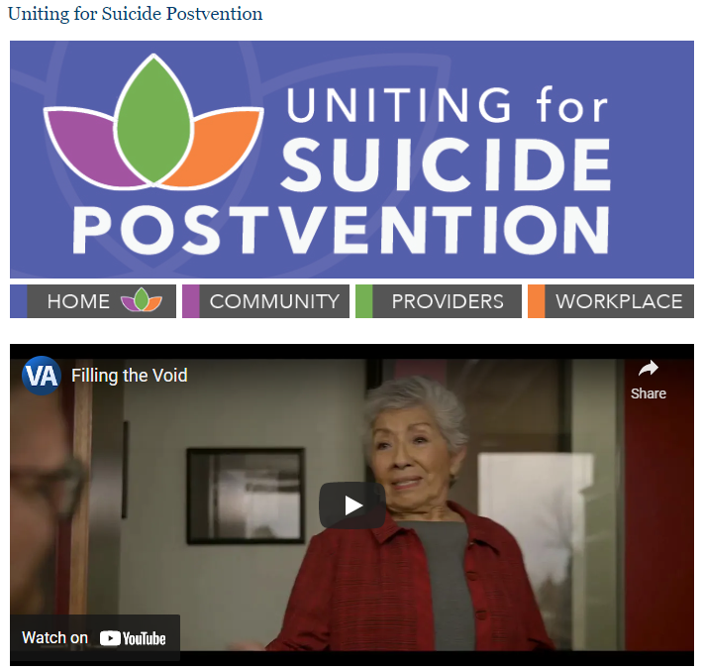
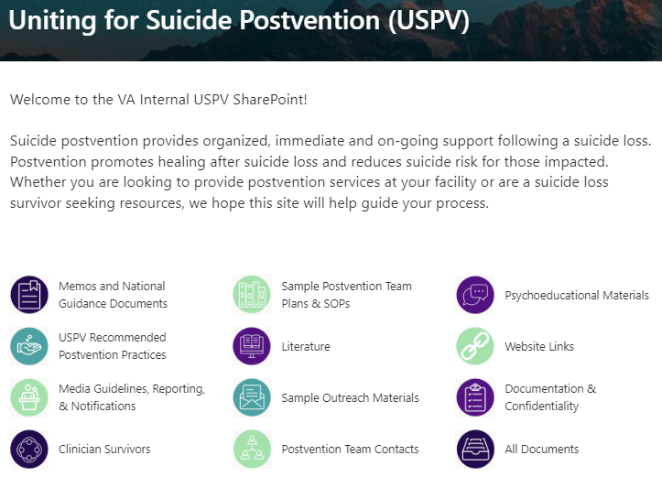
Uniting for Suicide Postvention
USPV offers resources and support to those impacted by suicide loss to promote healing and reduce suicide risk.
SRM also offers consultation to facilities / leaders (e.g., planning postvention responses, developing postvention teams) and providers (e.g., to process a patient suicide loss)
https://www.mirecc.va.gov/visn19/postvention/
Notes:
Uniting for Suicide Postvention Website - An externally facing website that offers resources, guidance and support to those affected by suicide loss. The website offers cinematic films and interviews with suicide loss survivors, podcasts featuring suicide prevention experts, and infographics about suicide loss and ways to help.
Uniting for Suicide Postvention SharePoint- An internal VA SharePoint that features national and VA guidelines that support key components of postvention work including safe messaging guidelines, tools to establish postvention teams, and recommendations for how to provide postvention services at the facility level.

Slide 53

Stay Connected
Follow us on social media to stay up to date on our programs and initiatives.
@deptvetaffairs
U.S. Department of Veterans Affairs
Veterans Health
Administration
@DeptVetAffairs @veteranshealth

Slide 54
Questions?

